Slide 1

Title: GenePHIT Phase II Trial: AB-1002 for Congestive Heart Failure (CHF)
Introduction to Foundations in Biotechnology BIOT5120 Final Project Outline (Group 5)
Submitted by:
Rishvika Shruthi Vankadara
Rithika Yadav
Sai Pravallika Sathiraju
Vaishali Jain

Slide 2
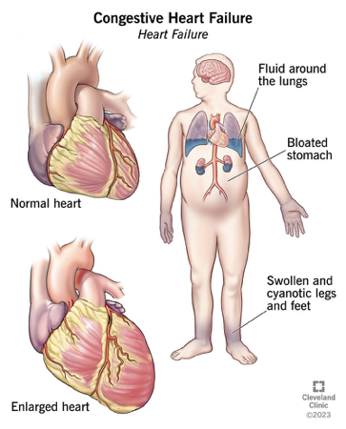
Section 1: Introduction to AB-1002
The primary disease targeted by the drug AB-1002 (NAN-10) is congestive heart failure (CHF) (Professional, n.d.).
It's estimated that about 26 million people are affected by CHF.
The 4 most common etiologies responsible for about two-thirds of CHF cases are ischemic heart disease, chronic obstructive pulmonary disease (COPD), hypertensive heart disease, and rheumatic heart disease (Professional, n.d.).

Slide 3
Mechanism Of Action
The biological mechanism of congestive heart failure (CHF) involves the heart's diminished capacity to pump blood effectively, This can be due to:
1. Including pressure and volume overload
2. Loss of muscle
3. Primary muscle disease or excessive peripheral demands such as high output failure (Professional, n.d.).
Congestive Heart Failure Causes & Symptoms
Causes :
High Blood Pressure
Faulty Heart Valves
Myocarditis
Congenital Heart defects
Diabetes
Symptoms :
Chest Pain
Fainting or severe weakness
Rapid or irregular heart beat
Sudden, severe shortness of breath

Slide 4
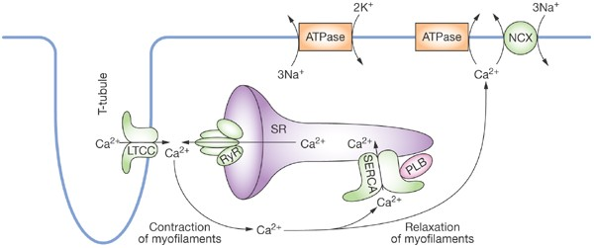
Protein Malfunction
In congestive heart failure (CHF), the malfunction can occur in several proteins involved in heart muscle contraction and blood flow regulation (Kawase & Hajjar, 2008).
These protein malfunctions can lead to impaired cardiac output and the symptoms associated with CHF.
This includes proteins that regulate calcium handling, such as the sarcoplasmic reticulum Ca²⁺-ATPase (SERCA2a), which is crucial for muscle contraction and relaxation, and proteins involved in the stress response of heart muscle cells, such as beta-adrenergic receptors (Kawase & Hajjar, 2008).

Slide 5
Why this Drug?
The choice to target congestive heart failure (CHF) for treatment would likely be driven by its high prevalence and significant impact on patient health, the potential for a gene therapy to offer a novel and more effective treatment option, and the opportunity to improve quality of life and reduce mortality in a condition that often has limited treatment options.
Gene therapy for congestive heart failure offers a novel and precise treatment approach, targeting underlying genetic factors to potentially enhance efficacy and personalize treatment, thereby improving quality of life and reducing mortality.

Slide 6
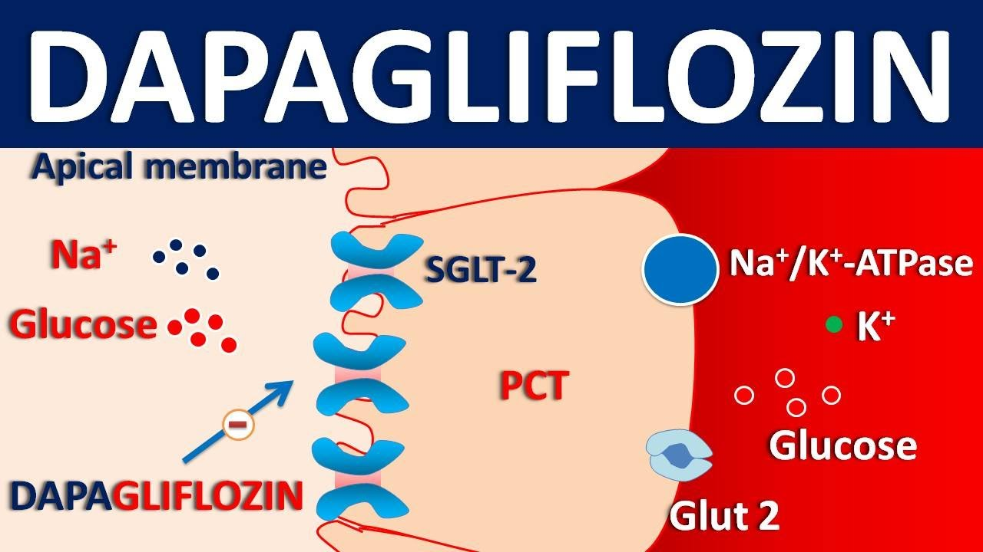
Section 2 FDA Approved Drugs for Congestive Heart Failure
Farxiga (Dapagliflozin):
Farxiga's SGLT2 inhibition lowers blood glucose levels, indirectly addressing heart failure risk in diabetes. Its potential cardioprotective effects may further benefit heart health (Heart Failure Medication for Adults | FARXIGA® (Dapagliflozin), n.d.).
Mechanism Of Farxiga:
Cardioprotective Effects
Glycemic Control
SGLT2 Inhibition

Slide 7
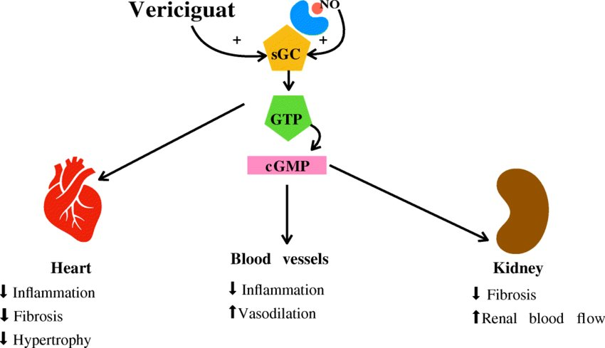
FDA Approved Drugs for Congestive Heart Failure
Mechanism Of Verquvo:
Verquvo (Vericiguat):
Vericiguat stimulates soluble guanylate cyclase (sGC), leading to increased production of cyclic guanosine monophosphate (cGMP). Elevated cGMP levels result in beneficial effects on the heart, blood vessels, and kidneys, including reducing inflammation, fibrosis, and hypertrophy in the heart, promoting vasodilation in blood vessels, and improving renal function (Sahana et al., 2023).
(Cardiovascular and Noncardiovascular Effects of Vericiguat. Figure., n.d.)

Slide 8
Medication Logistics of Farxiga & Verquvo
Drug | Method of Delivery | Dosage | Stability Factors | Shelf Life | Storage
Farxiga (Dapagliflozin) | Oral, Tablet Form | 5 mg, 10 mg | Temperature, humidity, light exposure | 12.9 ~13 hours | Cool, dry place, no direct sunlight or moisture
Verquvo (Vericiguat) | Oral, Tablet Form | 2.5 mg, 5 mg, 10 mg | Temperature, humidity, pH | 20 - 30 hours | Room temperature: 20°C - 25°C
(Heart Failure Medication for Adults | FARXIGA® (Dapagliflozin), n.d. ; Sahana et al., 2023).

Slide 9
AB-1002 V/S Farxiga & Verquvo
CHARACTERISTICS | AB-1002 | FARXIGA & VERQUVO
Unmet Need | Targets underlying molecular mechanisms of CHF | Targets fluid overload and hemodynamic imbalances but not molecular CHF abnormalities.
Mechanism of Action | Targets PP1 inhibitor (I-1) protein, enhancing cardiac function | Farxiga: Inhibits sodium-glucose cotransporters; Verquvo: Stimulates soluble guanylate cyclase, leading to vasodilation and improved cardiac function
Administration | Antegrade intracoronary artery infusion | Oral tablets
Development Stage | Phase II clinical trials | FDA approved and available on the market.
Safety and Side Effects | Safety profile being evaluated in clinical trials | Known side effects include dehydration, urinary tract infections, hypotension
Duration of Action | Potential for long-lasting or permanent effects with single administration | Requires daily administration for ongoing effect
Personalization | Can be tailored to individual patients based on genetic makeup and disease characteristics | One-size-fits-all approach
Potential for Disease Modification | Aims to modify disease progression by targeting underlying molecular causes | Primarily focuses on symptom management and hemodynamic improvements

Slide 10
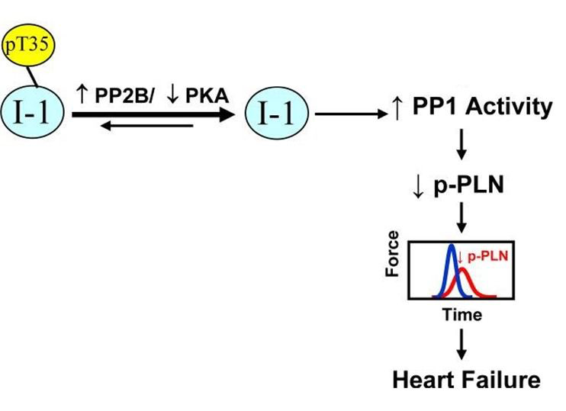
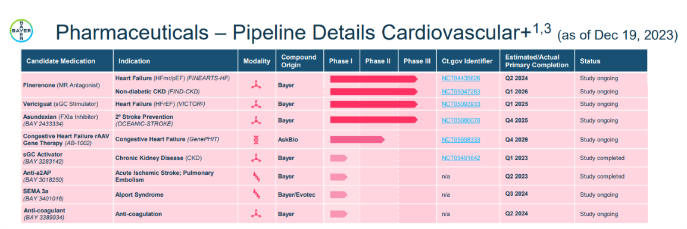
Section 3 Overview of gene therapy where is our drug in the pipeline?
AB-1002 is a gene therapy that delivers the constitutively active form of PP1 inhibitor (I-1) protein directly into damaged heart cells & to treat the underlying genetic or molecular causes of non-ischemic cardiomyopathy, in order to prevent or slow its progression.
The above picture shows the path of AB-1002 in the pipeline
Impaired regulation of PP1 by I-1 in heart failure.

Slide 11
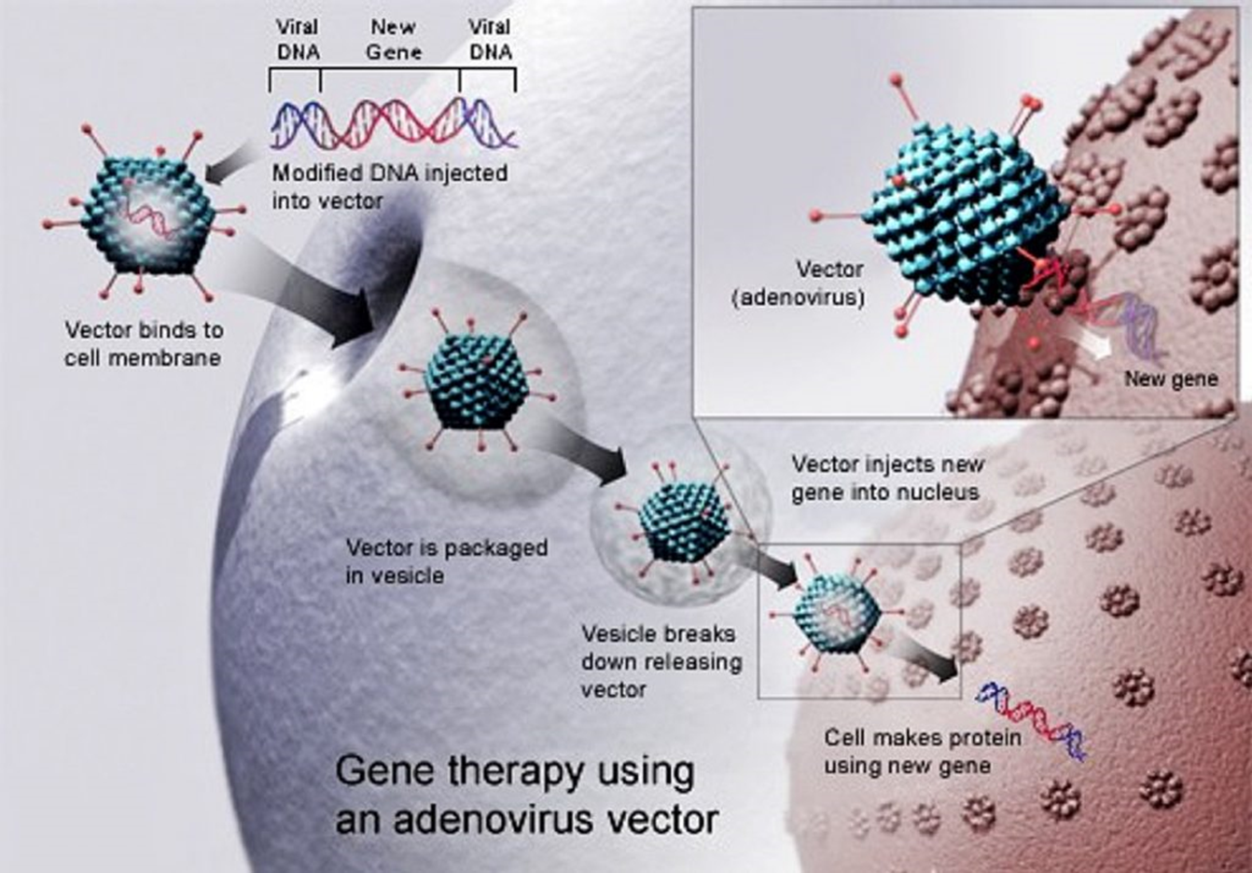
About Drug
Drug Development Status: The drug is in its Phase II trials.
Chemical Structure : AB-1002 is a cardiotropic adeno-associated virus(AAV) vector gene which promote increased production of a therapeutic protein inhibitor 1 in cardiac cells.

Slide 12
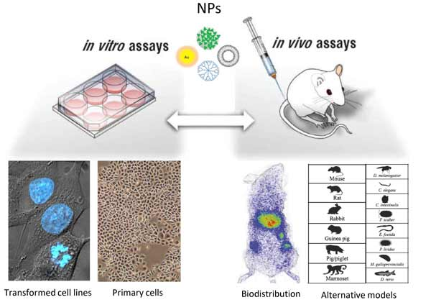
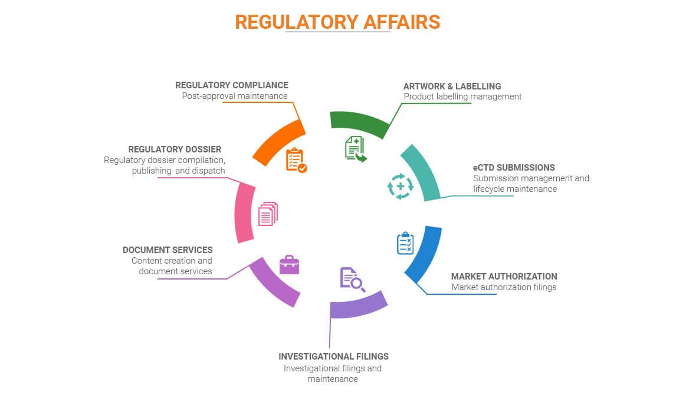
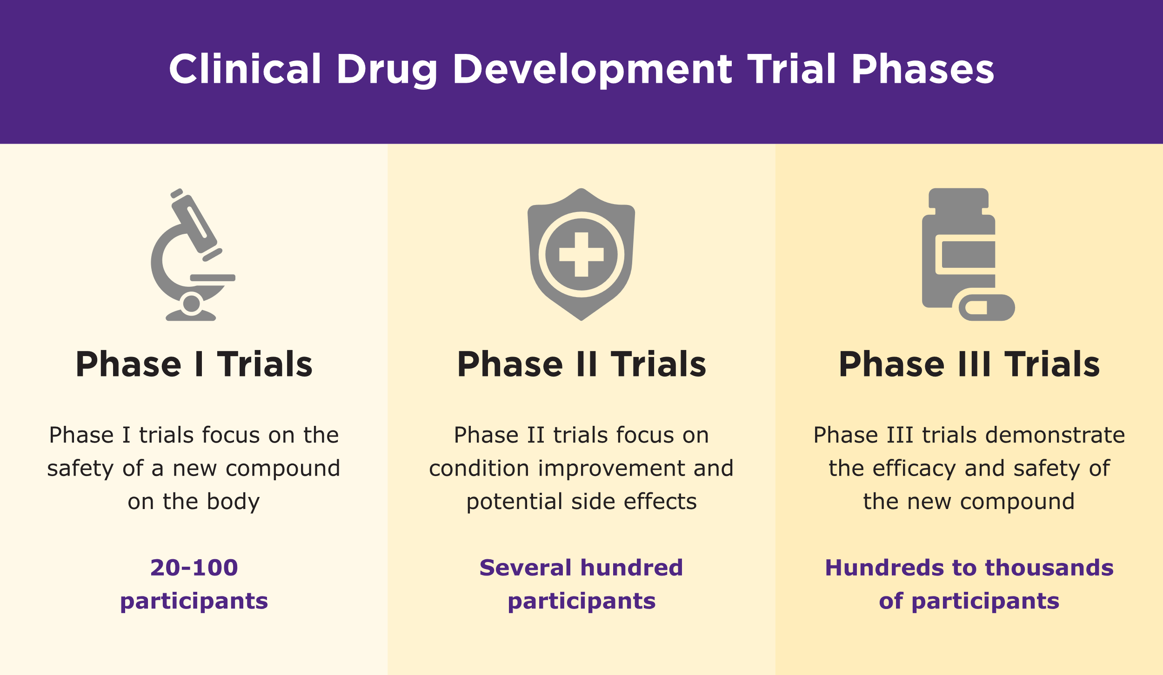

Target Validation
Preclinical Validation
Clinical Validation
Regulatory Affairs Review
Post-Market Surveillance
(Lacalle, 2024),(PPD Inc., 2024)

Slide 13
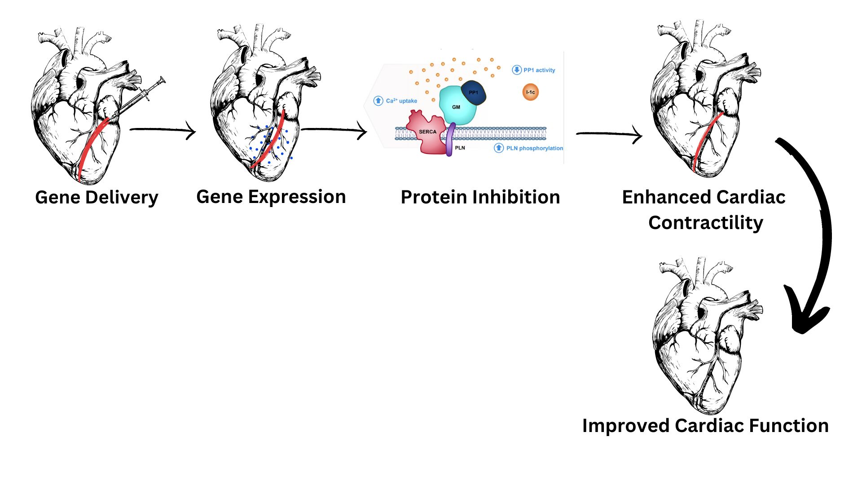
Administration Pathway
AB-1002 is a cardiotropic adeno-associated virus(AAV) one-time intracoronary infusion, administered via injection to the heart, designed to deliver an active I-1 transgene to promote the production of protein inhibitor 1, which can block the activity of the congestive heart failure-linked protein phosphatase 1 (Maznyczka et al., 2021)

Slide 14
Pharmacokinetics & Pharmacodynamics Of AB-1002 (Lainščak et al., 2016).
Pharmacokinetics (PK) Administration Distribution Metabolism Expression Elimination
Pharmacodynamics (PD) Onset of Action Mechanism Therapeutics Duration of Effect Clinical Efficacy

Slide 15
Clinical Trails
Trail name &Phase | Description/Primary Goal | Design | Date | No.of Patients | Sponsors
Pre Clinical | In this trial, the main goals of ASKBIO are as follows: 1.The delivery method (viral vector) 2.Dosage ranges 3.Safety profile 4.Treatment's efficacy 5.Screening period | Gene Therapy Administration of one-time infusion of AB-1002 by cardiac catheterization and infusion into the arteries of the heart | 27 November 2019 |  | AskBio & Bayer AG (Bayer, 2023)
GenePHIT/ Phase 1 | Patients with symptomatic congestive heart failure will be enrolled until up to 12 subjects have received infusions of investigational product. | Multi-center, open-label, sequential dose escalation | 19 November 2022 | 6 patients | AskBio & Bayer AG (Bayer, 2023)
GenePHIT/ Phase 2 | Evaluate the safety and efficacy of a single intracoronary infusion of AB-1002 in adults with non-ischemic cardiomyopathy subjects are randomized into one of three treatment groups in a 1:1:1 fashion to either low dose, high dose, or placebo. | Adaptive, double-blind, placebo-controlled, randomized, multicenter | 19 October 2023 | 90-150 patients | AskBio & Bayer AG (Andy Studna, Editor, 2024)

Slide 16
Discovery Research (AskBio, 2023).
Target Identification
Gene Selection
Vector Development
Proof of Concept
Mechanistic Studies
Collaborations and Funding
Regulatory & Scale-up Strategy
Patent Filings
Efficacy and Safety Profiles
Optimization

Slide 17
IP Research
Gene therapy vector patents cover AAV vectors for therapeutic gene delivery, including modifications for enhanced cardiotropic properties (Russell & Rutledge, 1997).
Therapeutic gene patents protect genetic sequences of I-1 protein, with modifications for stability and activity in cardiac cells.
Manufacturing process patents encompass novel methods for AAV vector and therapeutic gene production, purification, and formulation (Russell & Rutledge, 1997).
Method of use patents claim AAV-I-1 gene therapy for heart failure treatment, specifying subtypes like non-ischemic cardiomyopathy (Russell & Rutledge, 1997).
Delivery system patents protect unique methods for antegrade intracoronary artery infusion delivery (Zhou & Wang, 2021).
Companion diagnostic patents safeguard tests for patient identification and treatment response monitoring (Zhou & Wang, 2021).
Patent statuses include filed, issued, international, and pending litigation (Zhou & Wang, 2021).

Slide 18
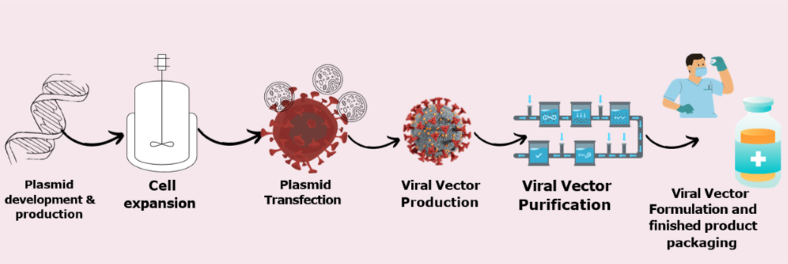
Manufacturing
These are the steps for manufacturing process for Carfostin (AB-1002), a gene therapy. (Biorender.2024)

Slide 19

Pricing
The pricing of Carfostin (AB-1002) will be influenced by factors such as research and development expenses, manufacturing costs, treatment efficacy, market exclusivity, healthcare cost savings, and reimbursement strategies. Final pricing will be determined post-Phase III trials and will reflect the balance between recouping development costs and providing value based on the therapy’s benefits compared to existing treatments. Pricing strategies will also take into account regulatory guidelines and market access programs.(TrueParallel, 2024).

Slide 20

Ethical Issues
Ethical issues in the development and use of Carfostin (AB-1002) involve considerations around informed consent, equitable access, fair pricing, data privacy, long-term monitoring, and the implications of genetic modification. Addressing these challenges requires collaboration among developers, regulators, ethicists, and patient groups to ensure the therapy is developed and used responsibly (Cruz, 2024).

Slide 21
Summary
AB-1002 (NAN-101), a gene therapy targeting protein phosphatase 1 (PP1) to enhance hear function.
AB-1002 is Administrated through Antegrade intracoronary artery infusion.
Improvement in heart function, quality of life, adverse events assessed.
Phase I and Phase II trials conducted, involving 150 participants with NYHA Class III heart failure and non-ischemic cardiomyopathy.
Viralgen Vector Core the manufacturer of AB-1002.
Data privacy, legislative transparency, are the Ethical constraints faced.
Contrasted with Farxiga and Verquvo, AB-1002 targets underlying CHF processes potentially revolutionizing treatment.
AB-1002 Could significantly benefit CHF patients worldwide with more effective and personalized treatment.

Slide 22
References
AskBio. (2023, November 12). AskBio Presents Preliminary Data from Phase 1 Trial of Gene Therapy for Congestive Heart Failure (CHF) at the 2023 American Heart Association Scientific Sessions. AskBio. https://www.prnewswire.com/news-releases/askbio-presents-preliminary-data-from-phase-1-trial-of-gene-therapy-for-congestive-heart-failure-chf-at-the-2023-american-heart-association-scientific-sessions-301985319.html
Boraschi, D., & Italiani, P. (n.d.). Model Validity in Nanoimmunosafety: Advantages and Disadvantages of In vivo vs In vitro Models, and Human vs Animal Models. http://www.eurekaselect.com. https://www.eurekaselect.com/article/76123
Cardiovascular and noncardiovascular effects of vericiguat. Figure. . . (n.d.). ResearchGate.
https://www.researchgate.net/figure/Cardiovascular-and-noncardiovascular-effects-of-vericiguat-Figure-legend-NO-nitroxigen_fig1_354008448
Cruz, P. C. (2024, April 12). Resolving ethical issues in sales and marketing.
https://www.ai-bees.io/post/ethical-issues-in-sales-and-marketing-how-to-resolve-them
Heart Failure Medication for Adults | FARXIGA® (dapagliflozin). (n.d.).
https://www.farxiga.com/heart-failure/understanding?source=FRX_C_C_9415&umedium=cpc&uadpub=GOOGLE&ucampaign=USA_GO_SEM_B_FARXIGA-DTC-CONSIDERATION-GENERAL-2024&ucreative=HF&uplace=farxiga+heart+failure&outcome=DTC&cmpid=1&cid=PPC-accountype:GOOGLE-campaign:USA_GO_SEM_B_FARXIGA-DTC-CONSIDERATION-GENERAL-2024-searchterm:farxiga+heart+failure-adgroup:HF-keywordid:p79661840000&gclsrc=aw.ds&
Kawase, Y., & Hajjar, R. J. (2008). The cardiac sarcoplasmic/endoplasmic reticulum calcium ATPase: a potent target for cardiovascular diseases. Nature Clinical Practice Cardiovascular Medicine, 5(9), 554–565.
https://doi.org/10.1038/ncpcardio1301
Lacalle, H. (2024, February 16). Post-Market Surveillance - 10 Questions about PMS & MDR. Decomplix.
https://decomplix.com/post-market-surveillance-pms/
Lainščak, M., Vitale, C., Seferović, P., Spoletini, I., Trobec, K., & Rosano, G. M. (2016). Pharmacokinetics and pharmacodynamics of cardiovascular drugs in chronic heart failure. International Journal of Cardiology, 224, 191–198. https://doi.org/10.1016/j.ijcard.2016.09.015

Slide 23
References
Maznyczka, A., McCartney, P., Duklas, P., McEntegart, M., Oldroyd, K. G., Greenwood, J. P., Muir, D., Chowdhary, S., Gershlick, A., Appleby, C., Eteiba, H., Cotton, J., Wragg, A., Curzen, N., Tait, R. C., MacFarlane, P. M., Welsh, P., Sattar, N., Petrie, M. C., . . . Berry, C. (2021). Effect of coronary flow on intracoronary alteplase: a prespecified analysis from a randomised trial. Heart, 107(4), 299–312.
https://doi.org/10.1136/heartjnl-2020-317828
PPD Inc. (2024, March 18). Drug Discovery and Development Process | PPD Inc. PPD Inc.
https://www.ppd.com/what-is-a-cro/drug-discovery-and-development/ Professional, C. C. M. (n.d.). Congestive heart failure. Cleveland Clinic. https://my.clevelandclinic.org/health/diseases/17069-heart-failure-understanding-heart-failure
Russell, D. W., & Rutledge, E. A. (1997, June 11). US6156303A - Adeno-associated virus (AAV) isolates and AAV vectors derived therefrom - Google Patents. https://patents.google.com/patent/US6156303A/en
Sahana, U., Wehland, M., Simonsen, U., Schulz, H., & Grimm, D. (2023). A Systematic Review of the Effect of Vericiguat on Patients with Heart Failure. International Journal of Molecular Sciences, 24(14), 11826. https://doi.org/10.3390/ijms241411826
TrueParallel. (2024, April 18). AskBio receives FDA Fast Track Designation for AB-1002 investigational gene therapy program in congestive heart failure. AskBio. https://www.askbio.com/askbio-receives-fda-fast-track-designation-for-ab-1002-investigational-gene-therapy-program-in-congestive-heart-failure/
You are being redirected. . . (n.d.). https://www.techtammina.com/regulatory-affairs/
Zhou, W., & Wang, X. (2021). Human gene therapy: A patent analysis. Gene, 803, 145889. https://doi.org/10.1016/j.gene.2021.145889

Slide 24
THANK YOU

